Slide 1
Client Server Simulation Using OpenGL
A project by :
Mohammed Daaniyaal – 1BY15CS051
Bhargav Sagiraju – 1BY15CS016

Slide 2
Why a simulation?
Modern network architecture by itself is so vast and complex that it can confuse even the best of us because of several of its components and aspects. It is similar to teaching a kid about doing taxes.
A graphical representation always helps.

Slide 3
What it does ?
A graphical representation of Client Server in a network which helps the user understand how exactly the request and response during a handshake work.
It keeps it simple and gives an actual visual of the packet transfer between the client and server.

Slide 4
Why we need it ?
How exactly would you explain the basic part of an internet connection to someone who has no idea of how the internet serves information. Lets make it simpler, how would you explain what the internet actually is to a 5 year old? This question would definitely be better answered by a graphical system.

Slide 5
Screenshots

Slide 6
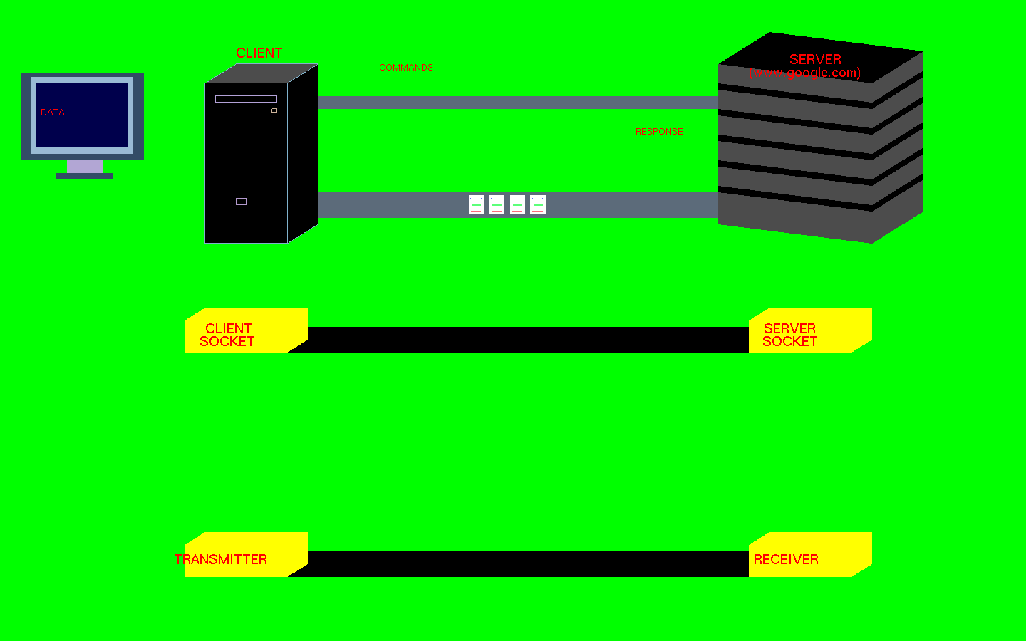
Transfer In Progress

Slide 7
A Professor or Teacher can explain how Client Server simulation works to a student and can explain even complex situations in TCP oriented network.
This will help several people understand how TCP connections work in real life.

Slide 8
Thank you.
This would not have been accomplished without the help of our guide Mr. Shankar R
We thank all our friends and family for their support.

